Slide 1

Cloud Computing
Waleed Afzal

Slide 2

Cloud Computing
Cloud computing refers to the delivery of computing services, including storage, processing power, networking, databases, analytics, and software, over the internet. Instead of owning and maintaining physical servers and infrastructure, individuals and organizations can access these services on a pay-as-you-go basis from a cloud service provider. The key characteristics of cloud computing include:

Slide 3

Types of Cloud Computing Services
Infrastructure as a Service (IaaS)
Platform as a Service (PaaS)
Software as a Service (SaaS)
Provides virtualized computing resources like virtual machines, storage, and network infrastructure.
Offers a platform for developing, testing, and deploying applications without worrying about infrastructure management.
Delivers software applications over the internet on a subscription basis, removing the need for local installation.

Slide 4

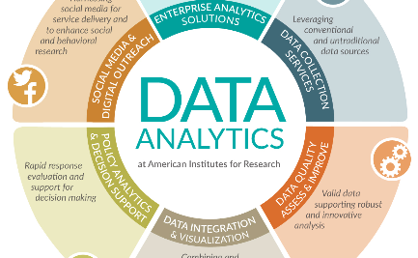

Common Cloud Computing Use Cases
E-Commerce
Data Analytics
Collaboration
Online stores can leverage cloud computing to handle high traffic, provide secure transactions, and scale based on demand.
Organizations can use cloud computing to process big data, perform complex analytics, and gain insights for decision-making.
Cloud-based tools enable real-time collaboration, document sharing, and seamless communication among geographically dispersed teams.

Slide 5

Future Trends in Cloud Computing
1
Edge Computing
Processing data closer to the source, reducing latency and bandwidth requirements for real-time applications.
Serverless Computing
2
Running applications without managing servers, enabling automatic scaling and cost optimization.
3
Hybrid Cloud
Combining public and private clouds to leverage the benefits of both for enhanced performance, security, and flexibility.

Slide 6

Conclusion
Cloud computing revolutionizes the way businesses and individuals consume and deliver computing resources. It enables innovation, cost savings, and scalability. Embracing cloud technologies requires careful consideration of the challenges and best practices to ensure security, compliance, and seamless operations.

